Slide 1
COMP 3100
Week 11 - Monday

Slide 2
Last time
What did we talk about last time?
Exam 2!
Before that: review
Before that:
  Deployment and maintenance

Slide 3
Questions?

Slide 4
Project 3

Slide 5
Task Identification and Effort Estimation

Slide 6
Task identification and effort estimation
As you probably can tell from working on Project 3, it's important for software managers to:
  Divide the development into tasks
  Estimate how long those tasks will take
Otherwise, it's impossible to plan:
  How long a development project will take
  How much it will cost
This information is central to traditional, waterfall processes
Even in agile, we need to decide on sprintable stories for a sprint

Slide 7
Task identification and organization
High level tasks are pretty easy to identify
  "Add networking support"
But that level of detail isn't very useful
Tasks are either:
  Non-decomposable, also called actions
  Decomposable, also called activities or processes
The right level of detail is called a work package
  A work package is a task that is small enough and detailed enough to estimate

Slide 8
Work breakdown structure
A work breakdown structure (WBS) can be used to map out tasks at the right level of abstraction
  The book prefers hierarchy diagrams to represent a WBS, since they balance the readability of trees with the space efficiency of hierarchical lists
Nodes in a WBS are work to be done
The root of a WBS is the project name
The first level is all the deliverables for a project
Each level below represents more and more detailed work
Leaf nodes are work packages

Slide 9
WBS example
The hierarchy diagram to the right shows a WBS for a home security product
Note that different strategies can be used to decompose the work, especially at different levels:
  Project deliverables
  Product features or services
  Project phases
  Organizational units
  Physical product decomposition
  Logical product decomposition
  Geographical location of team members

Slide 10
WBS heuristics
But how do you know if you've done a good job breaking things down?
One hundred percent rule: Nodes descended from a parent represent 100% of the work of the parent
  Nothing's left out
  No work is from outside the project
Mutually exclusive siblings: No sibling nodes have overlapping work
8 / 80 rule: Work packages (the leaves) take between 8 and 80 person-hours of effort
  Work in that range (one day to two weeks) can be estimated reasonably well
Get your project team and stakeholders together and make your WBS on a whiteboard

Slide 11
Effort estimation in traditional processes
In traditional processes, effort estimation can be done in a few ways:
  Analogy: Is your project like another project? It should take about the same effort
    Problem: Only works if your project is very similar to another project
  WBS to effort: Estimate the effort for each work package in a WBS and add them up
    Problem: It's really hard to estimate effort accurately
  Size to effort: Estimate the size of the final software product and use some math to predict how much work it will take to make the product
    Problem: Oh, so many problems, which we'll discuss

Slide 12
Measuring size
Functional measures of size have to do with how much functionality the program provides
  Number of pages on a website
  Number of reports in a database
  Number of windows in a GUI
Non-functional measures of size are based on the program's structure
  Lines of code
  Number of classes
Non-functional measures are easy to measure after development but hard to predict ahead of time

Slide 13
Lines of code
Lines of code (LOC) is a count of the lines of code needed for a project
  LOC is the most popular non-functional measure of size
Some people prefer source lines of code (SLOC), ignoring whitespace (and perhaps comments)
  It's even possible to weight some lines
  LOC is only meaningful in context, since some programming languages tend to take more LOC to get the same job done
Estimating LOC is done by breaking the product design into smaller and smaller components until the size of each component can be estimated
Accuracy is hard to achieve early on, since there isn't even a design yet
"Measuring programming progress by lines of code is like measuring aircraft building progress by weight."
-Bill Gates

Slide 14
Function points
Alternatively, a functional measure of size is possible called function points
Function points are calculated by looking at five different types of components, organized into two categories:
Processes or Transactions
  External Inputs (EI): Processes that provide data that will be used or stored by the product
  External Queries (EQ): Processes that retrieve stored data
  External Outputs (EO): Processes that provide derived information to a user (performing calculations)
Data Storage
  Internal Logical Files (ILF): Groupings of data maintained by the product
  External Interface Files (EIF): Groupings of data external to the product but used by the product

Slide 15
More on function points
Components of each kind contribute different amounts of effort
Likewise, there are simple, average, or complex cases
To account for these differences, we give a weight to each component based on this table
Measure | Simple | Average | Complex
External Inputs | 3 | 4 | 6
External Queries | 3 | 4 | 6
External Outputs | 4 | 5 | 7
Internal Logical Files | 7 | 10 | 15
External Interface Files | 5 | 7 | 10

Slide 16
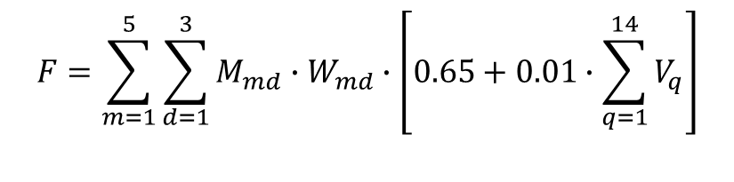
Final weights
It gets worse!
The whole number of function points is further weighted by answering each of the following 14 questions with a number between 0 (meaning not important) to 5 (meaning essential)
  Does the system require reliable backup and recovery?
  Are specialized data communications required?
  Are there distributed processing functions?
  Is performance critical?
  Will the system run in an existing, heavily utilized operational environment?
  Does the system require on-line data entry?
  Does the on-line data entry require input transactions over multiple screens or operations?
  Are the ILFs updated on-line?
  Are the inputs, outputs, files or inquiries complex?
  Is the internal processing complex?
  Is the code to be designed to be reusable?
  Are conversion and installation included in the design?
  Is the system designed for multiple installations in different organizations?
  Is the application designed to facilitate change and ease of use by the user?
The final number of function points is
$$F=\sum_{m=1}^{5}{\sum_{d=1}^{3}{M_{md}∙W_{md}}∙\left[0.65+0.01∙\sum_{q=1}^{14}{V_{q}}\right]}$$

Slide 17
Other methods
The Common Software Measurement International Consortium (COSMIC) proposed counting data movements
  Moving data from or to users or from or to storage
Roetzheim tweaked function points for web apps
  EI corresponds to input screens or forms
  EQ corresponds to externally published interfaces
  EO corresponds to HTML pages
  ILF corresponds to internal database tables or XML files
  ELF corresponds to external database tables or XML files
Boehm suggests object points instead of function points
  Three measures: screens in the interface, reports, and modules
  Each measure is simple, medium, or difficult (weighted appropriately)
  Object points are the sum of weighted measures multiplied by how much reuse there is (between 0 and 1)

Slide 18
Effort estimation
All these estimates of size give us some arbitrary number, but how much effort is needed?
Algorithmic cost models try to turn size estimates into a measure of effort called the person-month
  The amount of effort a normal developer does in one month
  Each person month has about 22 person-days
  Effort covers all work from requirements, design, coding, testing, documentation, collecting data, management, and so on

Slide 19
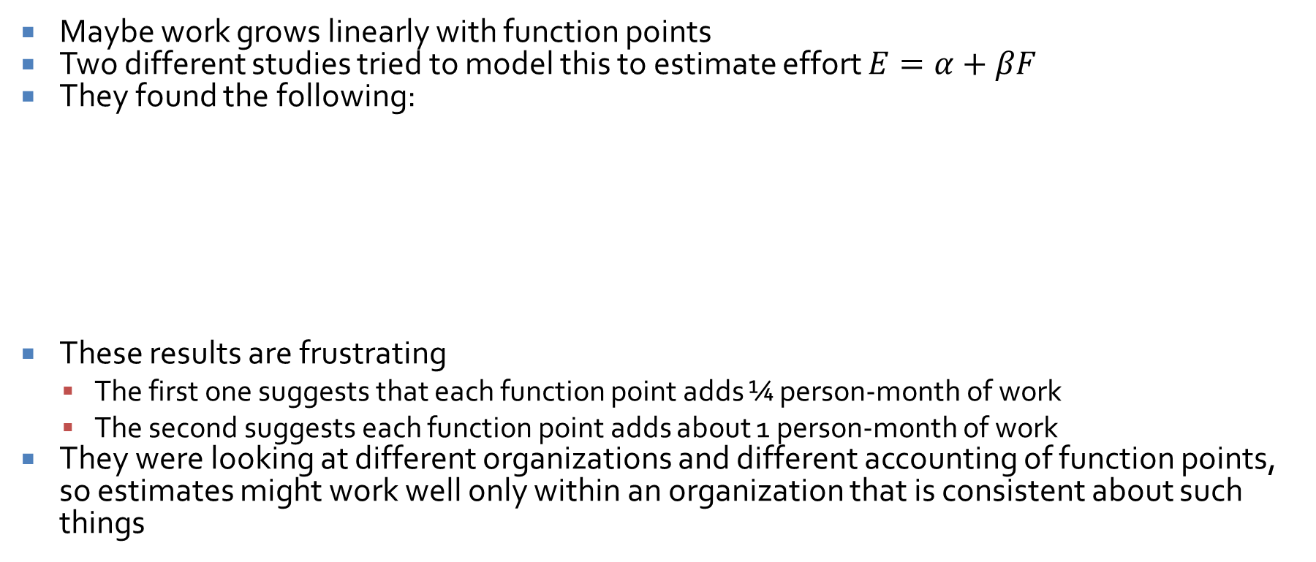
Simple models
Maybe work grows linearly with function points
Two different studies tried to model this to estimate effort $E=α+βF$
They found the following:
These results are frustrating
  The first one suggests that each function point adds ¼ person-month of work
  The second suggests each function point adds about 1 person-month of work
They were looking at different organizations and different accounting of function points, so estimates might work well only within an organization that is consistent about such things
Study | α | β
Albrecht and Gafney | -91.4 | 0.255
Kemerer | -37.0 | 0.960

Slide 20

Exponential models
Alternatively, some researchers have looked at exponential models relating thousands of lines of source code (KLOC) to total effort using the following equation, where L is KLOC:
  $E=α∙L^{β}$
Results found the following values of α and β:
Note here that β < 1 means economies of scale (time per line of code decreases at the project grows) while β > 1 means the opposite
Study | α | β
Watson and Felix | 5.20 | 0.91
Basili and Freburger | 1.38 | 0.93
Boehm | 3.20 | 1.05

Slide 21
State of the art
The book goes into the Constructive Cost Model (COCOMO) and its successor COCOMO II
  It uses some measure (either KLOC or function points)
  It tweaks an economy of scale parameter based on factors like how similar the project is to previous results and team cohesion
  It tweaks effort modifiers based on characteristics of the product, platform, team, and language
If it's not clear to you, we as an industry have no idea how to estimate effort
Your effort estimates are probably only meaningful if you can compare the product to a similar product made by a similar team

Slide 22
Effort estimation in Scrum
Everything we said before was about waterfall estimates
Scrum skips size estimates and goes straight for effort estimates
As you know, units of effort in Scrum are called story points (or sometimes task points)
  Story points are relative units
  They're based on some of the smallest tasks, using them as a baseline of 1 story point
  Everything is estimated relative to those
Story points aren't used for epics since they're too big and abstract
As PBIs get refined, their effort estimate gets refined too
By the time they're sprintable, they need a relatively accurate story point estimate
This means that there are good estimates for sprintable stories but no estimates for how much work the whole project will take

Slide 23
Detailed estimation in Scrum
What if members of the team disagree on the story points needed for several stories?
Agreement is needed for the sake of fairness and to plan how much work can actually get done in a sprint
Planning poker is a way to bring the team to consensus about the relative difficulty of user stories
Its goal is accuracy (ranking the stories by true difficulty) rather than precision (getting true estimates of how long things will take)
  It's really hard to get true estimates, but it's good to know which stories take more work

Slide 24
Planning poker
First, the team decides what numbers to use as estimates
The numbers are usually sequences that grow exponentially, written on cards
  Modified Fibonacci: 1, 2, 3, 5, 8 ,13, 20, 40, 100
  Powers of two: 1, 2, 4, 8, 16, 32, 64
  This means that large stories won't be estimated precisely, but that's okay
Planning poker has rounds
  Each round estimates the effort for one PBI
  Each team member throws in one card to show her effort estimation
  If all cards match, the value is the estimate
  If they don't match, the team discusses their estimates, focusing on the highest and lowest estimators
  Repeat the round until consensus is reached
It usually only takes a couple of rounds to reach consensus
Estimates are usually pretty good because of discussion

Slide 25
Upcoming

Slide 26
Next time…
Wednesday will be financial planning
Work day on Friday
  Please keep working during the week!
  Deadlines on your Gantt charts are flying by
  Please come to office hours for help!

Slide 27
Reminders
Read Chapter 13: Financial Planning for Wednesday
Keep working on Project 3

